Slide 1


Lecture 18: Adversarial NLP ”If it’s not broken …”, well, you’re probably wrong. It’s broken.
Harvard IACS
Chris Tanner

Slide 2
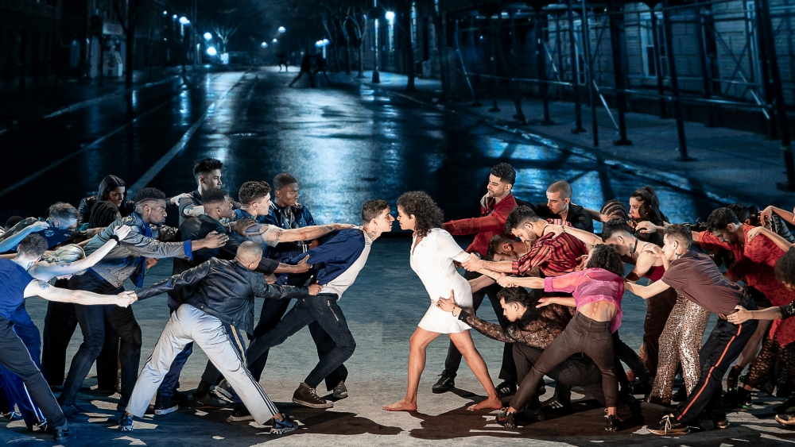
ADVERSARIAL NLP

Slide 3
ANNOUNCEMENTS
HW4 is due tonight @ 11:59
HW3 and Quiz 6 and Phase 3 are being graded
Research Project Phase 4 will be a soft-assessment
Many of today’s slides are based on, inspired by, or directly from Jack Morris (Cornell Tech), Mohit Iyyer (UMass Amherst), Graham Neubig (CMU)

Slide 4
Outline
Introduction
Paraphrasing
Workshop time
Modern approaches

Slide 5
Outline
Introduction
Paraphrasing
Workshop time
Modern approaches

Slide 6
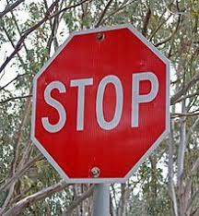
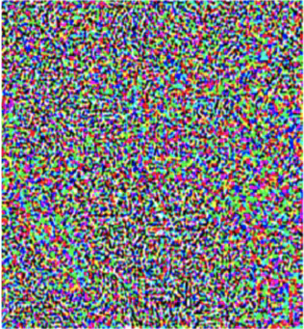
Motivation
+
=
Classified as a stop sign
Classified as a 70 mph speed limit sign
Goodfellow et al., 2014

Slide 7
Motivation

Slide 8
Motivation
Does this count?

Slide 9
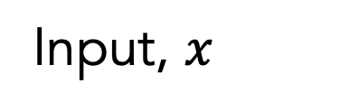
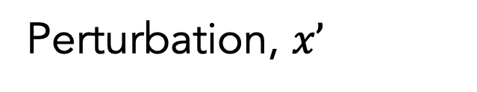
Example
Could add random noise at the character level.
Input, $x$
Perturbation, $x’$
“True Grit” was the best movie I’ve seen since I was a small boy.
“True Grit” was the best moive I’ve seen snice I was a small boy.
Prediction: positive
Prediction: negative

Slide 10
Example
Could add random noise at the character level.
Input, $x$
Perturbation, $x’$
“True Grit” was the best movie I’ve seen since I was a small boy.
“True Grit” was the best moive I’ve seen snice I was a small boy.
Prediction: positive
Prediction: negative
This is easy to defend against, right? How?

Slide 11
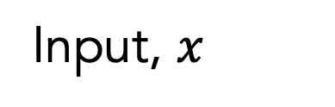
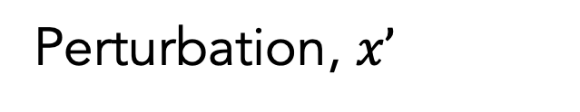
Example
Input, $x$
Perturbation, $x’$
Hi Enrique,
Did you get the photos that I sent from our hangout?
Hi Enrique,
Did u get the photoz that I sent from our hangout?
Prediction: not spam
Prediction: spam

Slide 12
Example
Could
train an RNN to identify and correct typos
use a spellchecker to auto-correct the input
Adversarial perturbations can be useful for augmenting training data
Pruthi et al., Combating Adversarial Misspellings with Robust Word Recognition (2019)

Slide 13
Example
Could replace at the word level
Input, $x$
Perturbation, $x’$
“True Grit” was the best movie I’ve seen since I was a small boy.
“True Grit” was the best movie I’ve seen since I was a tiny lad.
Prediction: positive
Prediction: negative
Slide based on, inspired by, or directly from Jack Morris

Slide 14
Entailment
Textual Entailment is the task of predicting whether, for a pair of sentences, the facts in the first sentence necessarily imply the facts in the second.

Slide 15
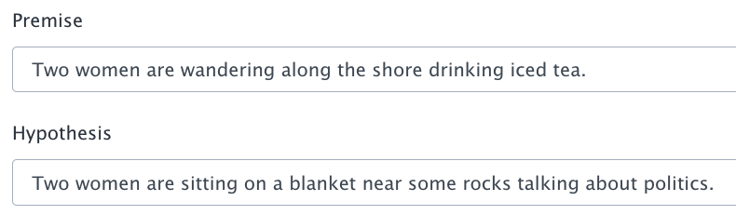
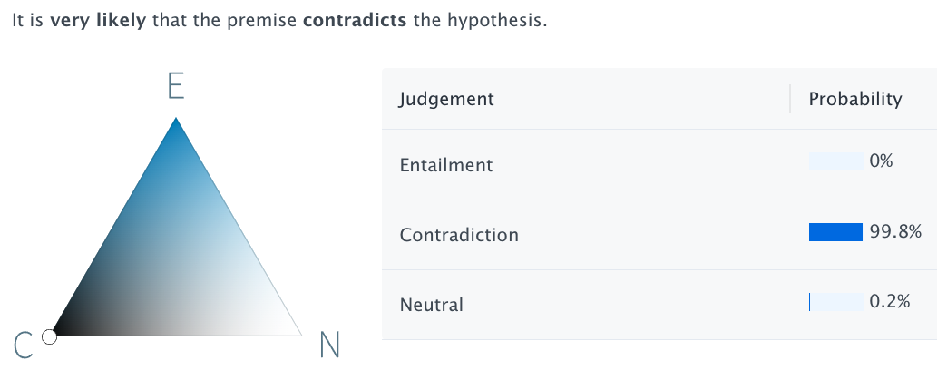

Slide 16
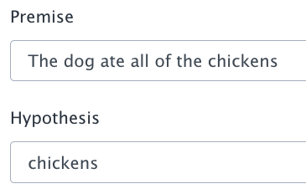
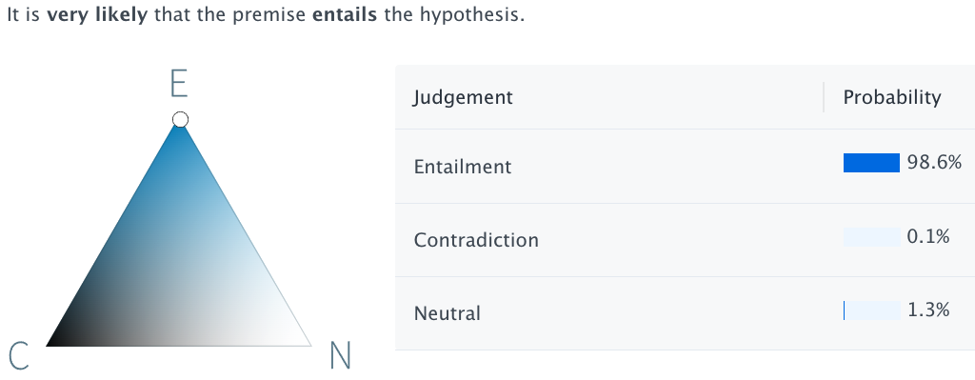

Slide 17
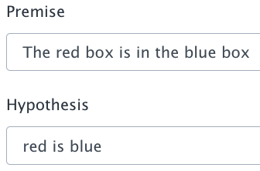
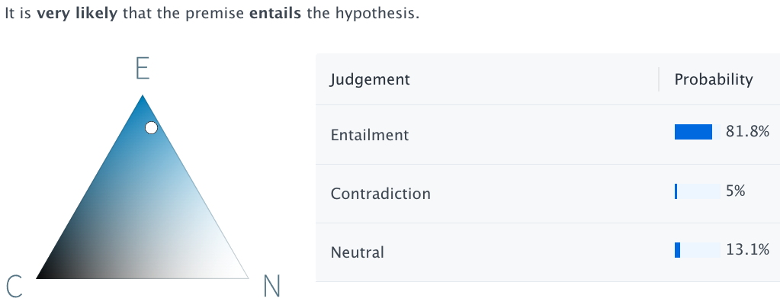

Slide 18
Adversarial?
EMNLP 2017 had a “build-it-break-it” workshop that challenged humans to break existing systems by creating linguistic-based adversarial examples
“i.i.d. training data is unlikely to exhibit all the linguistic phenomena that we might see at testing time”
“NLP systems are quite brittle in the face of infrequent linguistic phenomena, a characteristic which stands in stark contrast to human language users”
Slide based on, inspired by, or directly from Mohit Iyyer
Notes:
In general, this area has been popular since 2017, which followed from the foundation work in computer vision. This workshop focused on creating adversaries that are linguistically interesting. Perhaps you’ve come up w/ structures the model has never seen before, and it breaks the model.
Brittle: deep learning tidbit

Slide 19
Adversarial?
How do we differentiate between an adversarial attack versus a model that is just bad?

Slide 20
Adversarial
An adversarial attack should slightly alter the input in a way that is semantically equivalent to humans but yields an incorrect, adverse change in the model’s output

Slide 21
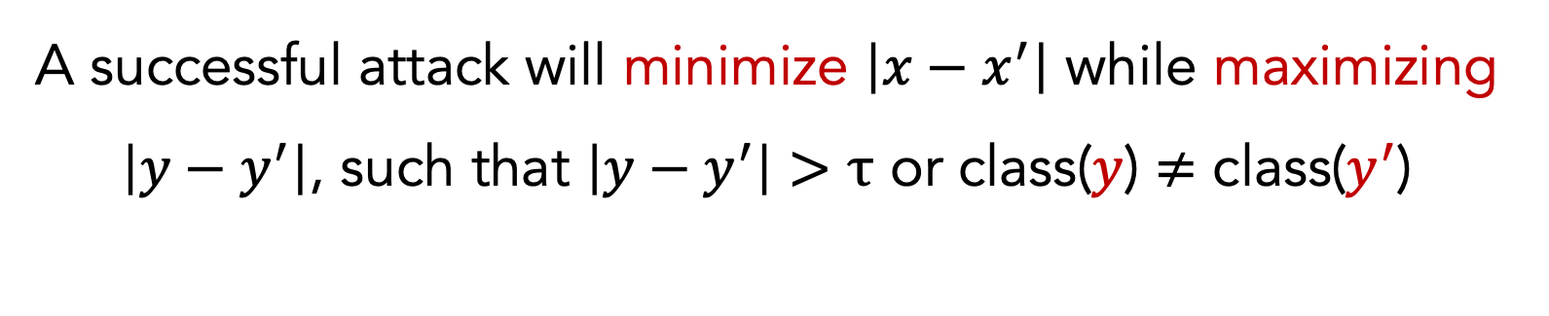
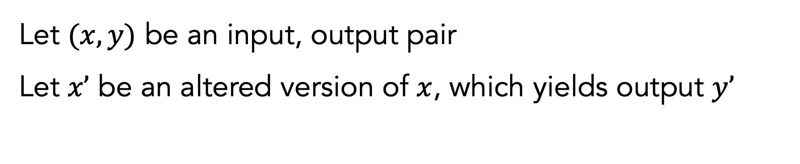
Adversarial
Let $(x,y)$ be an input, output pair
Let $x’$ be an altered version of $x$, which yields output $y’$
A successful attack will minimize $\left|x−x^{′}\right|$ while maximizing $\left|y−y^{′}\right|$, such that $\left|y−y^{′}\right|>τ$ or class($y$) $≠$ class($y^{′}$)

Slide 22
Outline
Introduction
Paraphrasing
Workshop time
Modern approaches

Slide 23
Outline
Introduction
Paraphrasing
Workshop time
Modern approaches

Slide 24
Paraphrasing
PROBLEM
How can we change text while preserving its meaning?

Slide 25
Paraphrasing
Word-level substitutions
(aka lexical adversaries)
Embeddings: search for nearest-neighbors in the embedding space
Thesaurus: look up the word in a thesaurus, WordNet, or PPDB
Hybrid: search for nearest-neighbors in the counter-fitted embedding space (Mrkšić et al, 2016)
Mrkšić et al., Counter-fitting Word Vectors to Linguistic Constraints (2016)

Slide 26
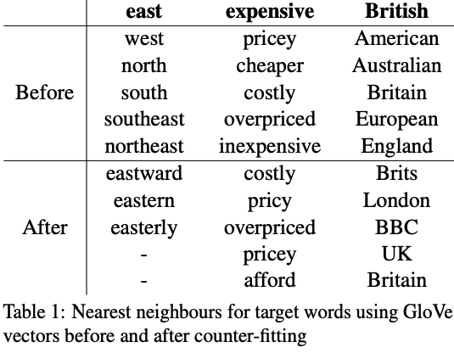
Paraphrasing
Word-level substitutions
Counter-fitted embeddings inject antonymy and synonymy constraints into vector space representations to help separate conceptual association from semantic similarity
Embeddings: search for nearest-neighbors in the embedding space
Thesaurus: look up the word in a thesaurus (or WordNet)
Hybrid: search for nearest-neighbors in the counter-fitted embedding space (Mrkšić et al, 2016)

Slide 27
Paraphrasing
Word-level substitutions are difficult to craft
(aka lexical adversaries)
How we can determine if a word swap is “acceptable” or not?
This can be approximated by, or includes, word sense disambiguation (WSD) and language modelling (LM)
Thus, can’t craft perfectly valid word substitutions all the time, but can do reasonably well

Slide 28
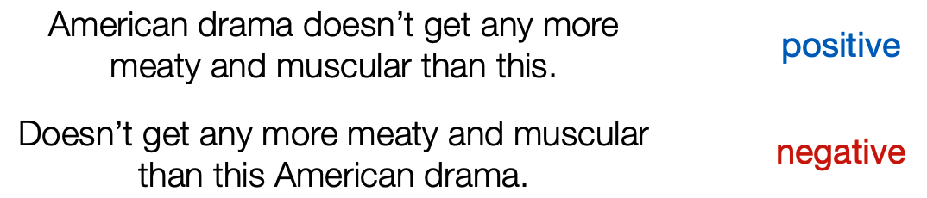
Paraphrasing
Sentence-level substitutions
(aka syntactic adversaries)
INPUT SENTENCE
MODEL PREDICTION
Example from Ettinger et al., 2017
Notes:
Here, we are actually changing the syntactic structure of the sentence. The model predicts negative.
For any given model, what is a set of adversarial examples where humans have an easy time discerning between but the model fails. We won’t have this magical set of adversarial examples for free, so you might want to create such via data augmentation.

Slide 29
Paraphrasing
How can we create these syntactic adversaries (aka sentence-level substitutions) automatically?

Slide 30
Paraphrasing
Sentence-level substitutions
(aka syntactic adversaries)
Cosine similarity between sentence embeddings of x and x’ (e.g., based on a Universal Sentence Encoder)
Substitute many phrases (e.g., PPDB 2.0)
Perform machine translation
Pavlick et al., PPDB 2.0: Better paraphrase ranking, fine-grained entailment relations, word embeddings, and style classification (2015)
Notes:
If we don’t want to rely on external resources such as a thesaurus or PPDB, we might want to turn to machine translation to perform paraphrase generation

Slide 31
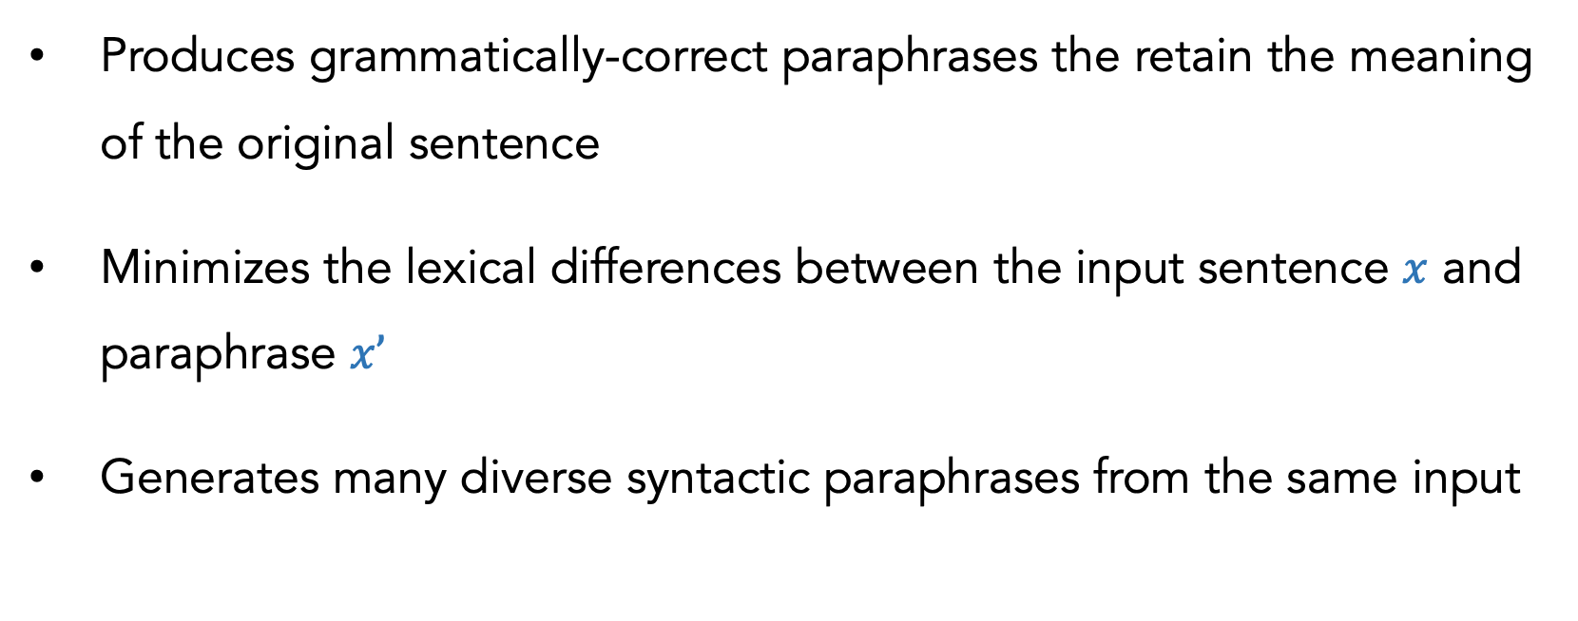
MT
Ideal syntactic paraphraser
Produces grammatically-correct paraphrases the retain the meaning of the original sentence
Minimizes the lexical differences between the input sentence $x$ and paraphrase $x’$
Generates many diverse syntactic paraphrases from the same input
Slide based on, inspired by, or directly from Mohit Iyyer
Notes:
Point 1: if we change the meaning, then that defeats the entire purpose. Our x’ needs to be close to x, however you want to imagine this
Point 3: we want to push the boundaries and create as many diverse structures as we can. We want it to be robust without returning the wrong answer

Slide 32
MT
Syntactic paraphrase generation
ORIGINAL
Usually you require inventory only when you plan to sell your assets
PARAPHRASES
Usually, you required the inventory only if you were planning to sell the assets
When you plan to sell your assets, you usually require inventory
You need inventory when you plan to sell your assets
Do the inventory when you plan to sell your assets
Slide based on, inspired by, or directly from Mohit Iyyer
Notes:
Many of these change the tense or hypotheticals.
Many different ways you can re-word this. This should remind you of MT, whereby there are many possible output sequences that contain may each be good.
We might want a metric that evaluates against *all* reference sentences.

Slide 33
MT
Syntactic paraphrase generation
These are grammatical, preserve input semantics, have minimal lexical substitution, and high syntactic diversity
ORIGINAL
Usually you require inventory only when you plan to sell your assets
PARAPHRASES
Usually, you required the inventory only if you were planning to sell the assets
When you plan to sell your assets, you usually require inventory
You need inventory when you plan to sell your assets
Do the inventory when you plan to sell your assets
Slide based on, inspired by, or directly from Mohit Iyyer

Slide 34
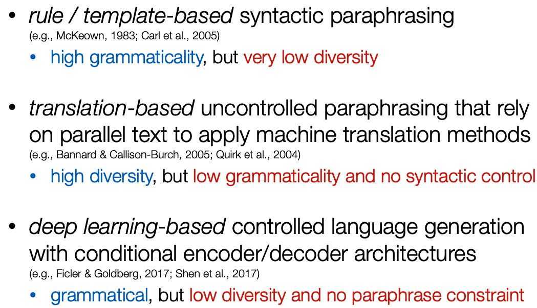
MT
Long history of paraphrase work
1
2
3
Slide based on, inspired by, or directly from Mohit Iyyer

Slide 35
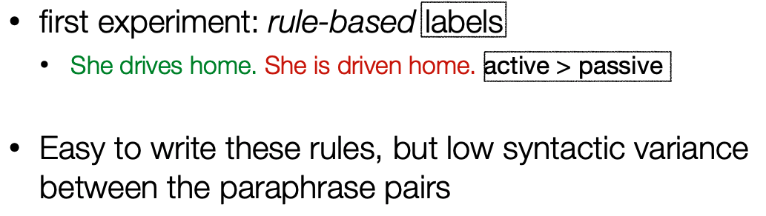
MT
1. Paraphrasing with descriptive syntactic transformations
Slide based on, inspired by, or directly from Mohit Iyyer

Slide 36
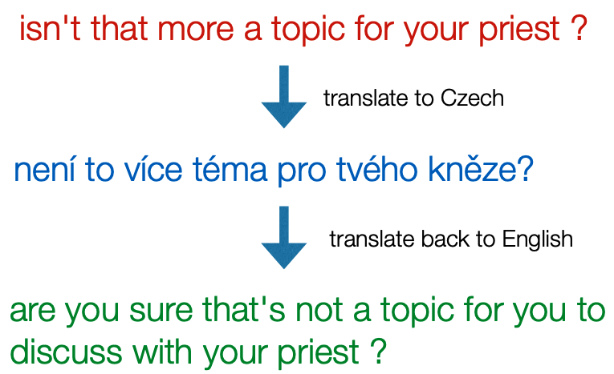
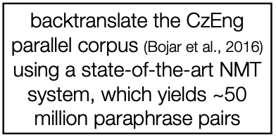
MT
2. Translation-based uncontrolled paraphrasing
BACK-TRANSLATION
Slide based on, inspired by, or directly from Mohit Iyyer

Slide 37
MT
2. Translation-based uncontrolled paraphrasing
Could use several intermediate languages for backtranslation
There is no control over how wild these sentences may get
Limited research on the diversity and quality, due to many moving parts (data available, metrics, required human annotation)

Slide 38
MT
3. Translation-based controlled paraphrasing
Step 1: Generate back-translation sentences from original sentences
Step 2: Run parser (e.g., constituency parsing) on the back-translation
Step 3: Train a new model that generates new text, conditioned on the original sentence and the parsed back-translation

Slide 39
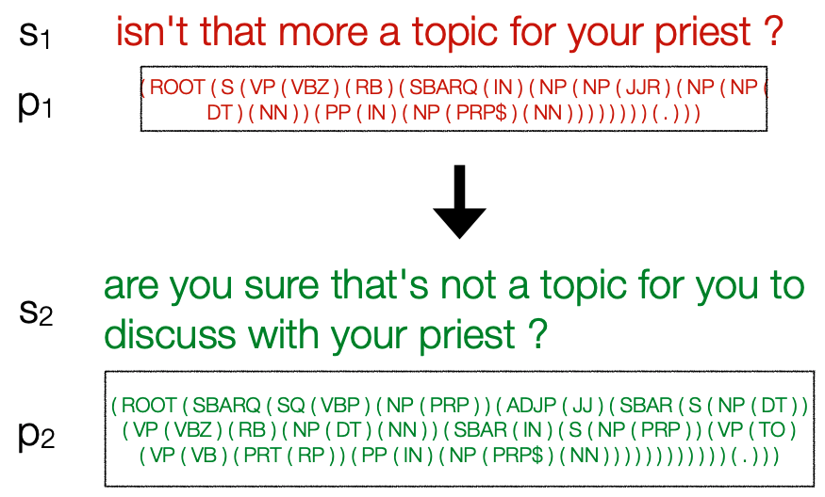
MT
3. Translation-based controlled paraphrasing
Step 1
Slide based on, inspired by, or directly from Mohit Iyyer

Slide 40
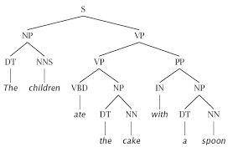
MT
3. Translation-based controlled paraphrasing
Step 2

Slide 41
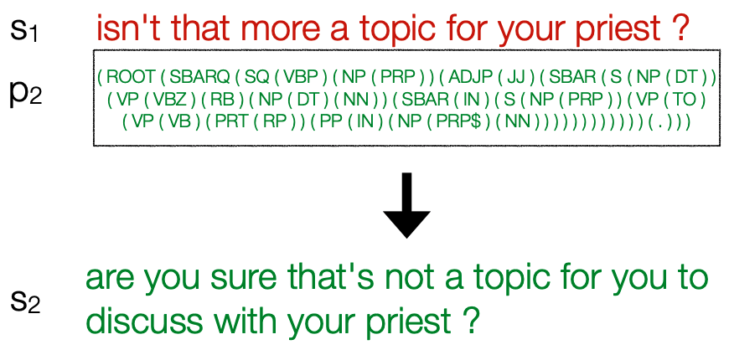
MT
3. Translation-based controlled paraphrasing
Step 3
Slide based on, inspired by, or directly from Mohit Iyyer

Slide 42
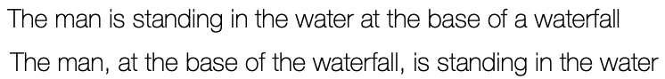
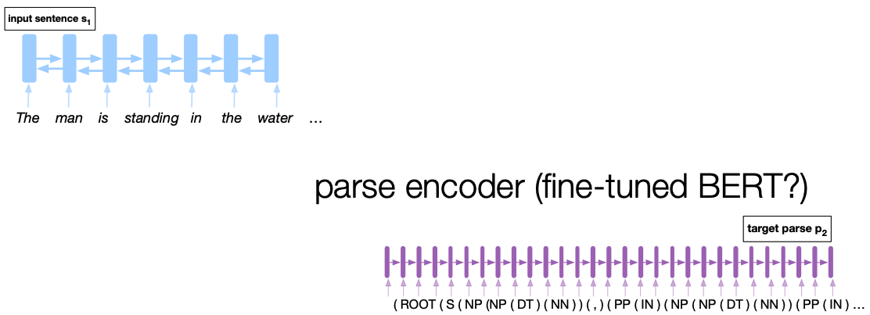
MT
Step 3 (SCPN system)
Slide based on, inspired by, or directly from Mohit Iyyer

Slide 43
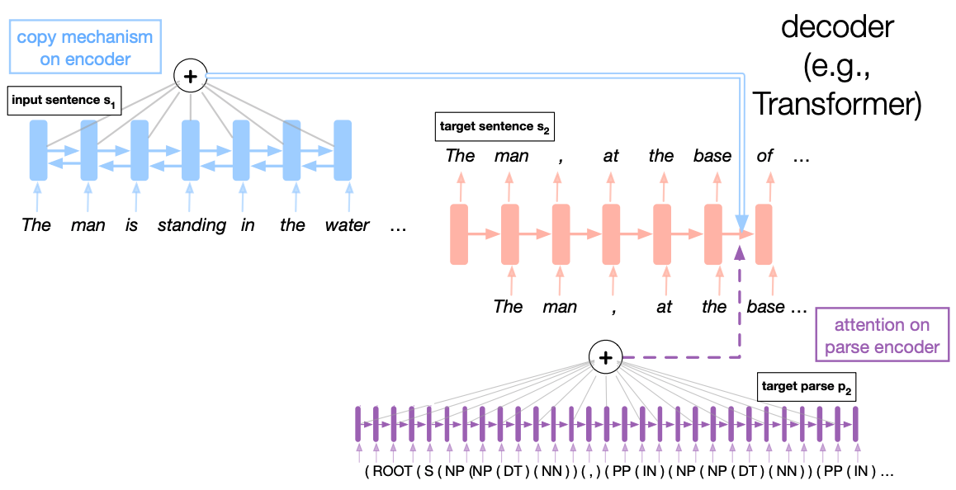
MT
Step 3 (SCPN system)
Slide based on, inspired by, or directly from Mohit Iyyer

Slide 44
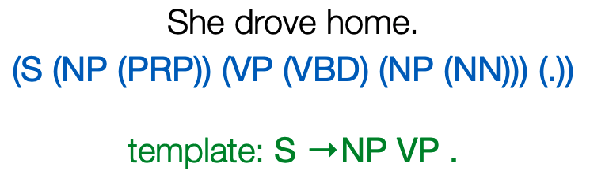
MT
3. Translation-based controlled paraphrasing
Conditioning on the full target parse could be too rigorous and demanding
Could “back-off” and use a pruned version of the parse
Slide based on, inspired by, or directly from Mohit Iyyer

Slide 45
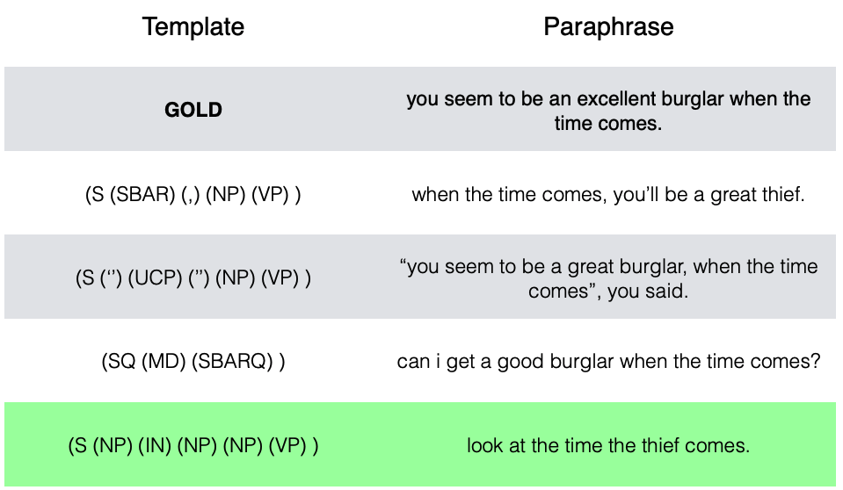
MT
3. Translation-based controlled paraphrasing
SCPN system
Iyyer et al., Adversarial Example Generation with Syntactically Controlled Paraphrase Networks (2018)

Slide 46
Outline
Introduction
Paraphrasing
Workshop time
Modern approaches

Slide 47
Outline
Introduction
Paraphrasing
Workshop time
Modern approaches

Slide 48
WORKSHOP TIME!
How would you analyze how vulnerable your model is to adversarial attacks?
How would you defend against such?

Slide 49
Outline
Introduction
Paraphrasing
Workshop time
Modern approaches

Slide 50
Outline
Introduction
Paraphrasing
Workshop time
Modern approaches

Slide 51
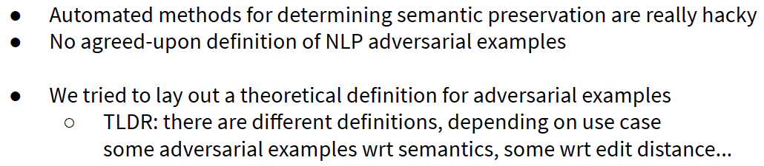
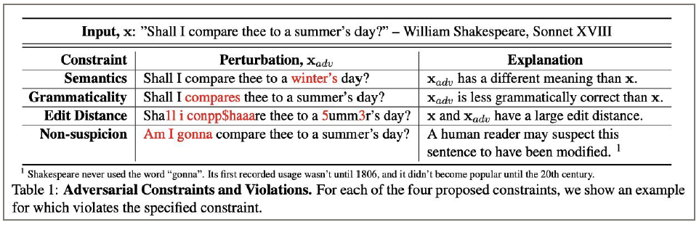
The field is budding (aka Wild West)
Morris et al., Reevaluating Adversarial Examples in Natural Language (2020)
Slide based on, inspired by, or directly from Jack Morris

Slide 52
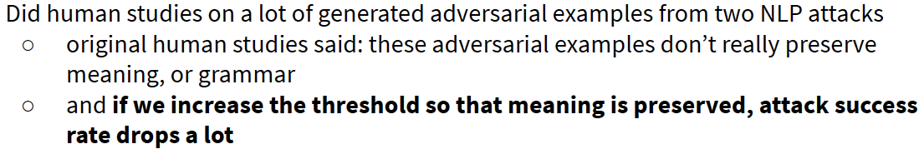
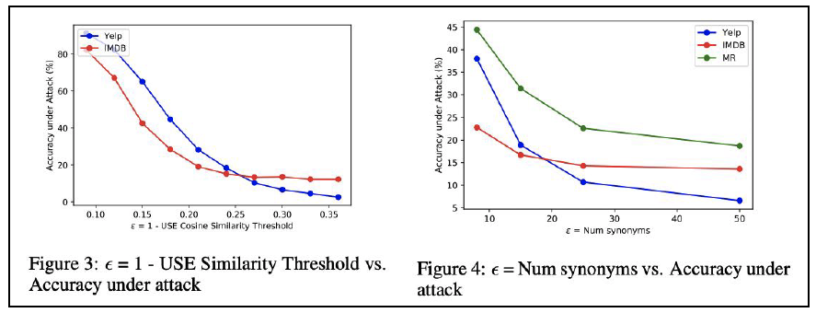
The field is budding (aka Wild West)
Morris et al., Reevaluating Adversarial Examples in Natural Language (2020)
Slide based on, inspired by, or directly from Jack Morris

Slide 53
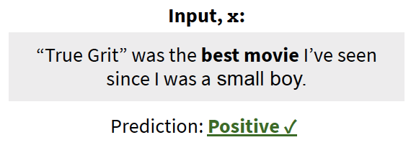
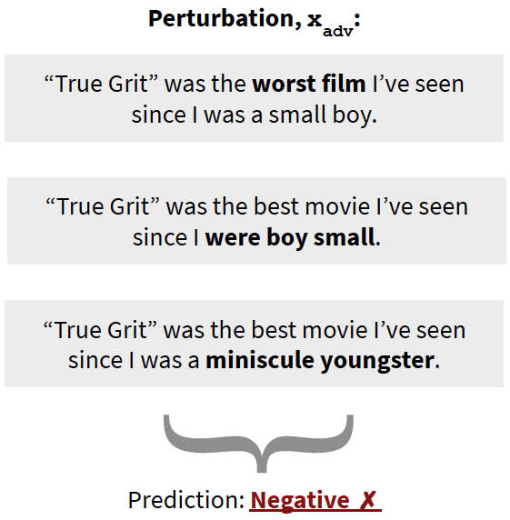
Examples of poor adversarial perturbations
Morris et al., Reevaluating Adversarial Examples in Natural Language (2020)
Slide based on, inspired by, or directly from Jack Morris

Slide 54
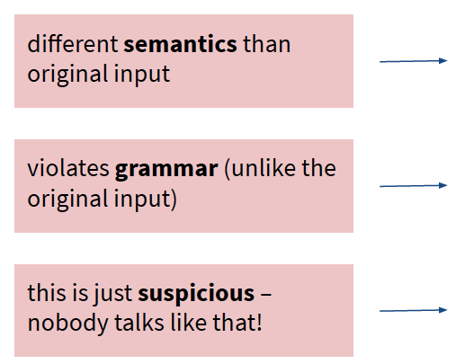
Examples of poor adversarial perturbations
Morris et al., Reevaluating Adversarial Examples in Natural Language (2020)
Slide based on, inspired by, or directly from Jack Morris

Slide 55
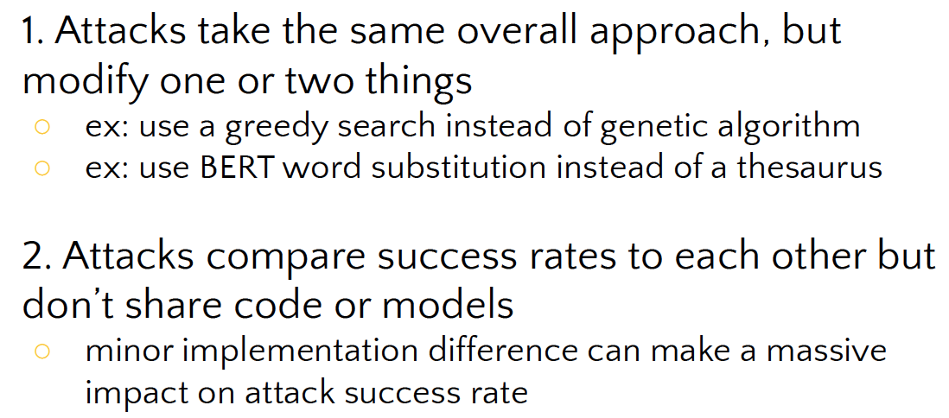
TextAttack
Trends within adversarial literature
Slide based on, inspired by, or directly from Jack Morris

Slide 56
TextAttack
Overview
A framework for Adversarial Attacks, Data Augmentation, and Adversarial Training
Attacks consists of 4 main components
Morris et al., TextAttack: A Framework for Adversarial Attacks, Data Augmentation, and Adversarial Training in NLP (2020)

Slide 57
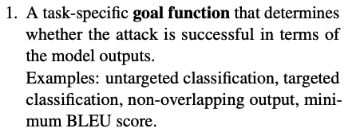
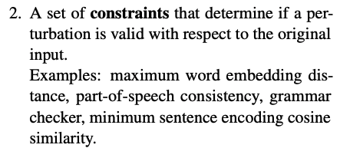
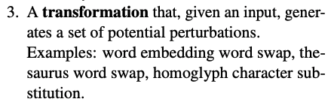
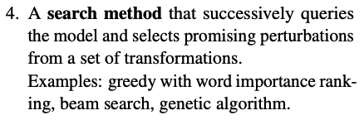
TextAttack
Overview
Morris et al., TextAttack: A Framework for Adversarial Attacks, Data Augmentation, and Adversarial Training in NLP (2020)

Slide 58
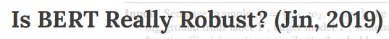
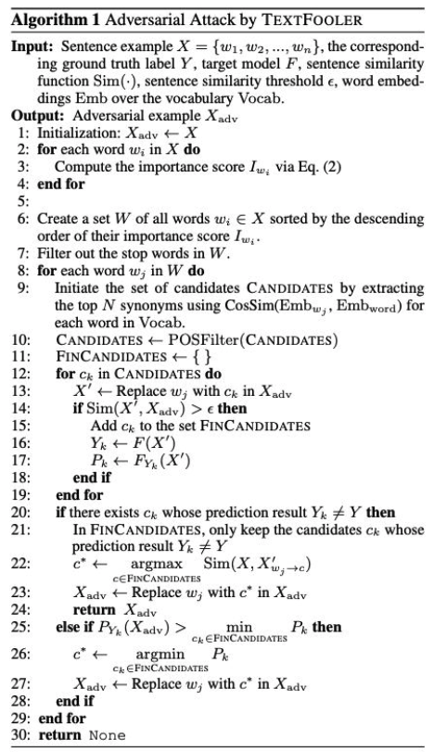
TextAttack Example
Morris et al., TextAttack: A Framework for Adversarial Attacks, Data Augmentation, and Adversarial Training in NLP (2020)

Slide 59
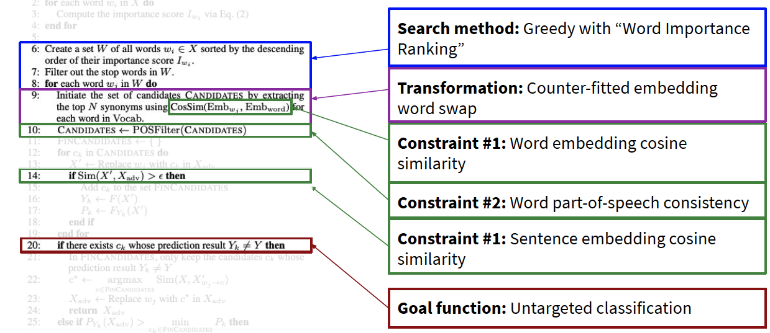
TextAttack Example
Morris et al., TextAttack: A Framework for Adversarial Attacks, Data Augmentation, and Adversarial Training in NLP (2020)

Slide 60
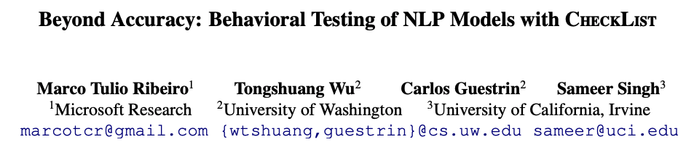
Better practices
Motivation: dev accuracy is very short-sighted and tends to over-estimate performance
This paper is inspired by principles of behavioral testing in software engineering
New evaluation methodology and accompanying tool for comprehensive behavioral testing of NLP models
Guides users in what to test, by providing a list of linguistic capabilities, which are applicable to most tasks.

Slide 61
Conclusion
Adversarial NLP is relatively new and still forming as a field
Touches on software testing, data augmentation, robustness, learning theory, etc
All systems can break; it’s highly informative to be aware of this and understand how your model breaks
One may want to analyze, defend, or attack.

